Slide 1
Ideas and steps about Ke et al. paper
-- Predicting Returns with Text Data
-- Zhongchen Wang

Slide 2
Main ideas
SESTM method (Sentiment Extraction via Screening and Topic Modeling)
A novel model-based approach: understand the sentimental structure of a text corpus without relying on pre-existing dictionaries.
Three main steps:
Screening for Sentiment-Charged Words: isolates the most relevant terms from a very large vocabulary of terms via predictive correlation screening
Learning Sentiment Topics: assigns term-specific sentiment weights using a supervised topic model
Scoring New Articles: uses the estimated topic model to assign article-level sentiment scores via penalized maximum likelihood

Slide 3
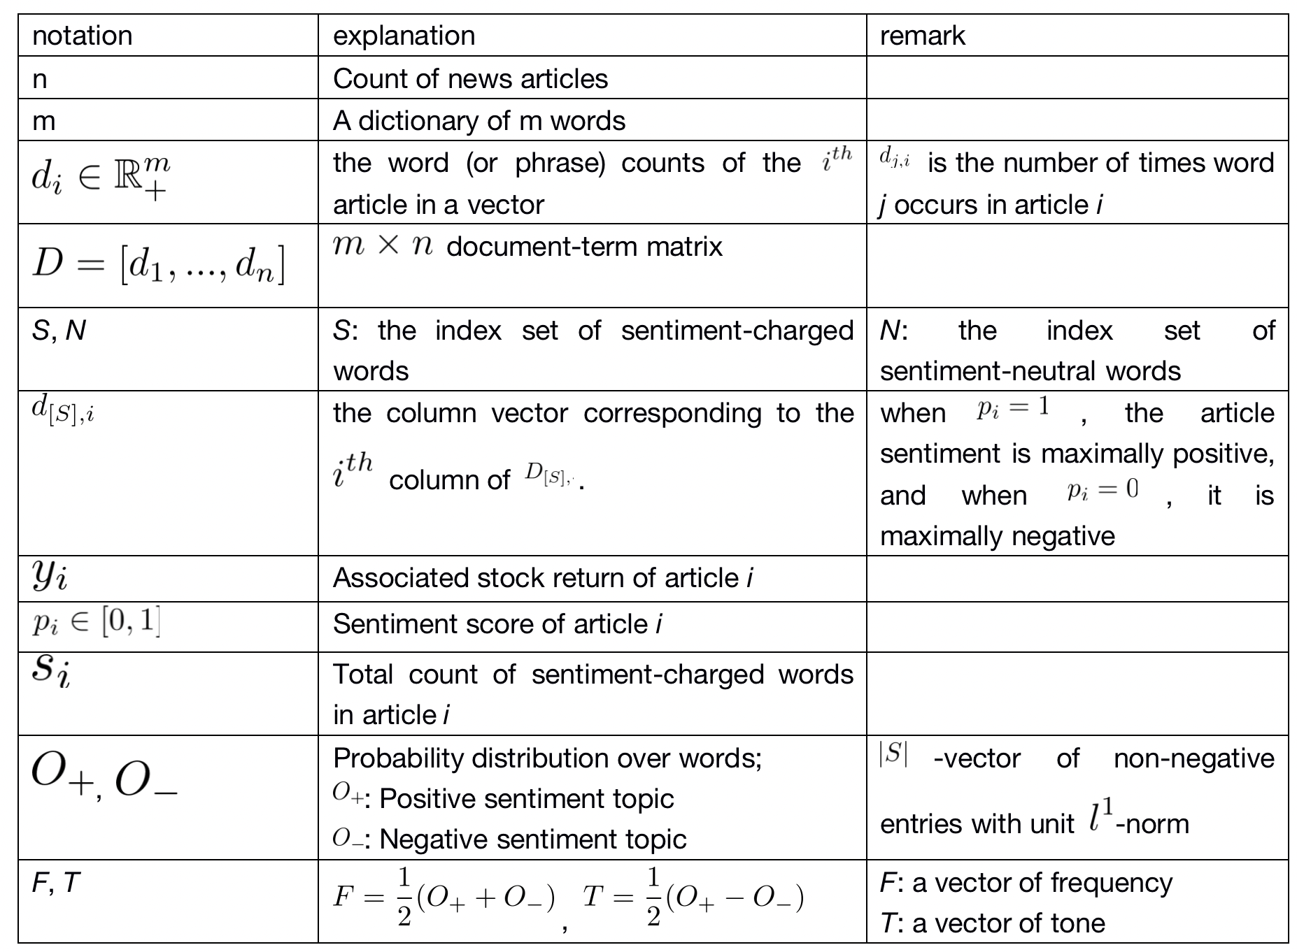
Notation

Slide 4
Dataset
Dataset
Dow Jones Newswires service, January 1984 - July 2017
Train the model using rolling window estimation.
Training and validation sample: January 1989 - January 2014: 15 year interval
Training: first 10 years
Validation: last 5 years
Out-of-sample Testing: subsequent one-year window
Roll the entire analysis forward by a year and re-train, iterate this procedure until exhaust the full sample, which amounts to estimating and validating the model 14 times.
Benchmark
A commercial vendor of financial news sentiment scores -- RavenPack

Slide 5
Data Pre-Processing
1 | combining“chained”articles
 | remove articles with more than one firm tag
 | Track the date, exact timestamp, tagged firm ticker, headline, and body text of each article.
2 | Timing choice
 | Using ticker tags, we match each article with tagged firm’s market capitalization and adjusted daily close-to-close returns from CRSP.
 | Without better guidance on timing choice, we train the model by matching articles published on day t (more specifically, between 4pm of day t - 1 and 4pm of day t) with the tagged firm’s three-day return from t - 1 to t + 1 (more specifically, from market close on day t - 2 to close on day t + 1).
3 | Set out of sample analysis time duration: February 2014 - July 2017

Slide 6
Data Pre-Processing
4 | Remove proper nouns
 | Clean and structure news articles -- bag of words Normalization changing all words in the article to lower case letters expanding contractions such as “haven’t” to “have not” deleting numbers, punctuations, special symbols, and non-English words Stemming and lemmatizing Group together the different forms of a word to analyze them as a single root word Tokenization Splits each article into a list of words Removes common stop words Translate each article into a vector of word counts

Slide 7
Step 1 -- Screening for Sentiment-Charged Words
Strategy: Isolate the subset of sentiment-charged words, and then estimate a topic model to this subset alone (leaving the neutral words unmodeled)
A supervised approach that leverages the information in realized stock returns to screen for sentiment-charged words.
Intuitively, if a word frequently co-occurs in articles that are accompanied by positive returns, that word is likely to convey positive sentiment.

Slide 8
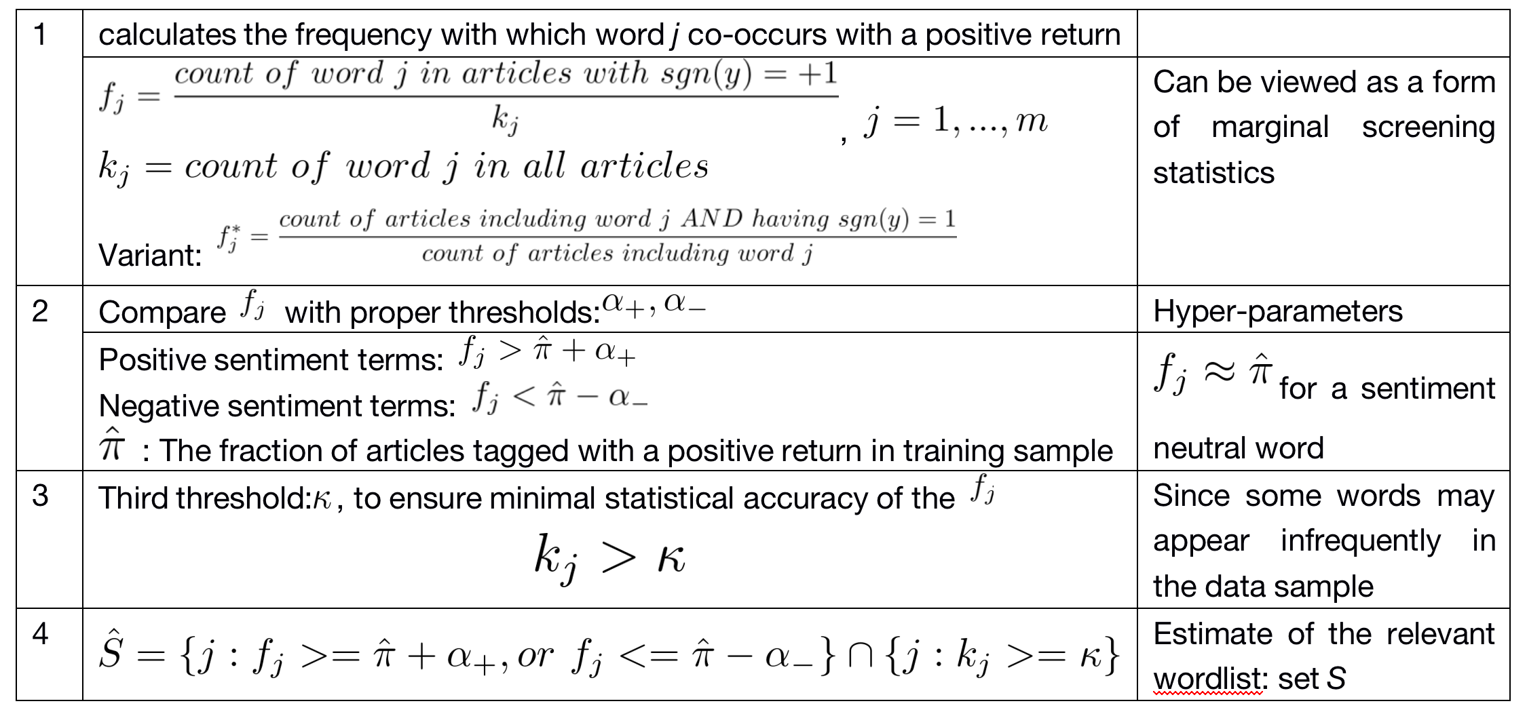
Step 1 -- Screening for Sentiment-Charged Words

Slide 9
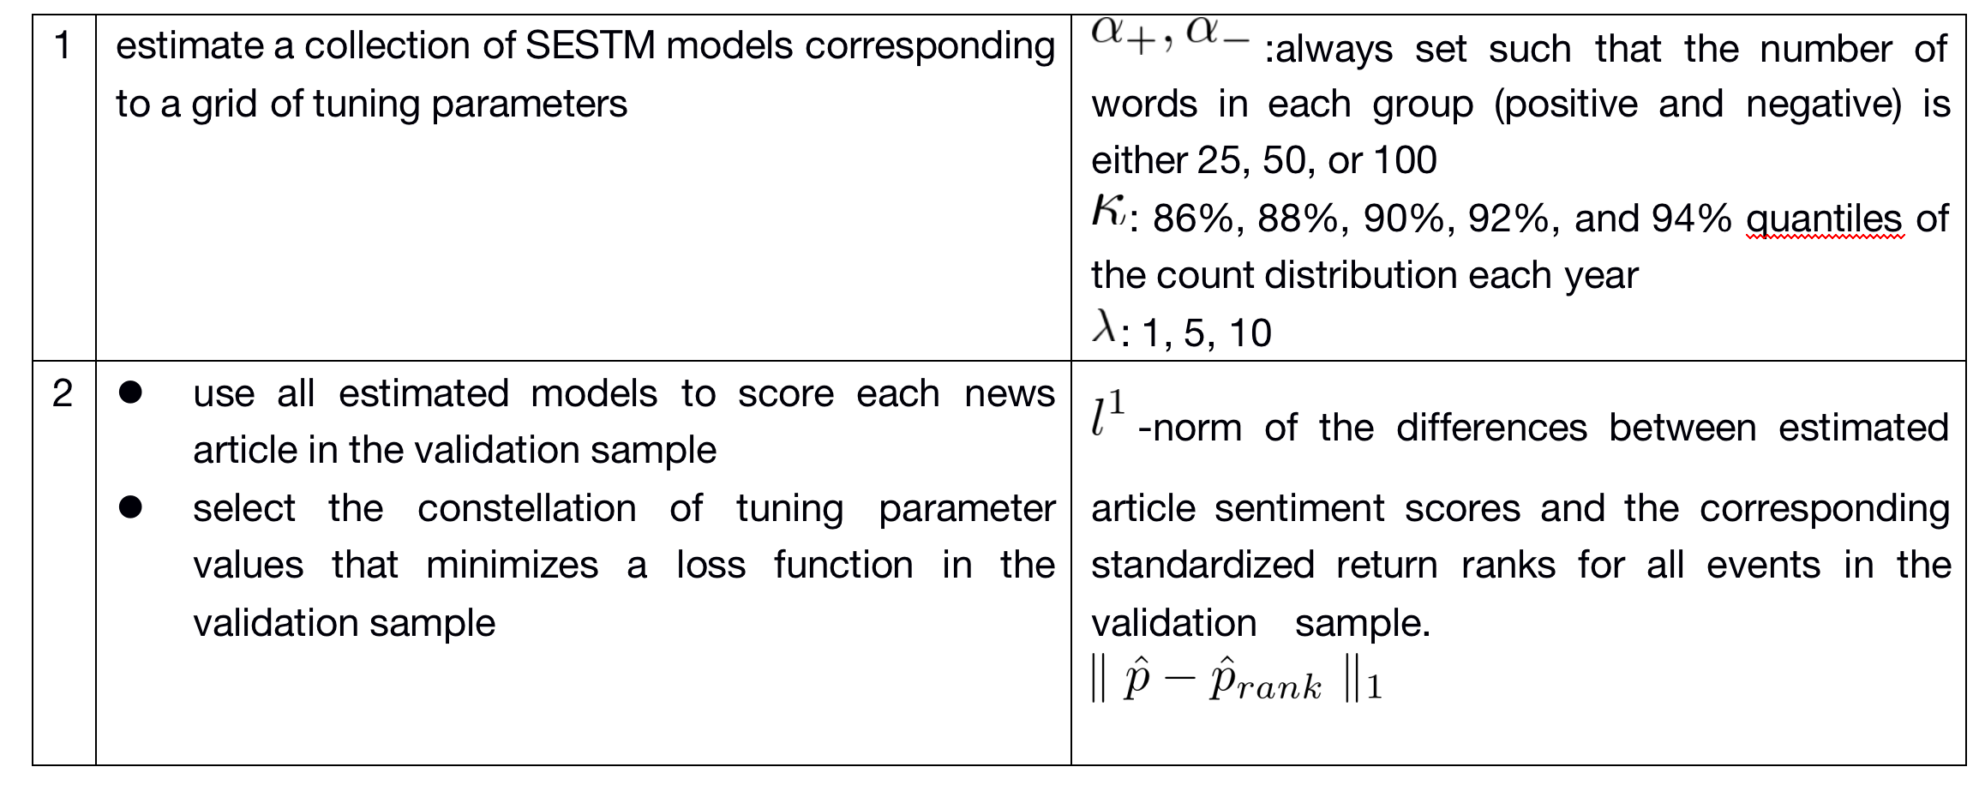
Step 1 -- Screening for Sentiment-Charged Words
Choice of parameter

Slide 10
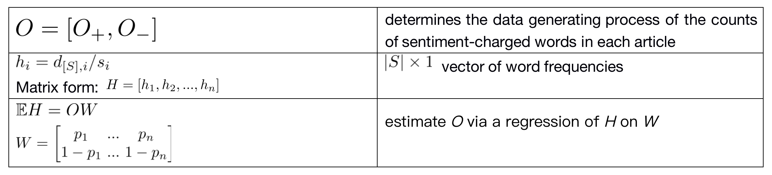
Step 2 -- Learning Sentiment Topics
Assigns term-specific sentiment weights using a supervised topic model.
Each Newswire is associated with a stock return, and the return contains information about article sentiment. Hence, returns serve as training labels.

Slide 11
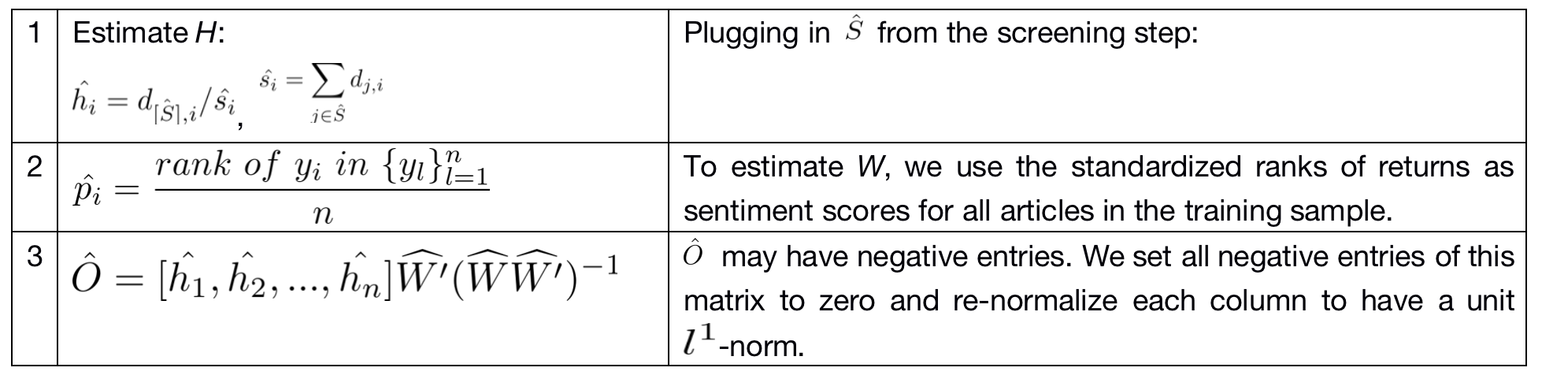
Step 2 -- Learning Sentiment Topics
Assigns term-specific sentiment weights using a supervised topic model.
Each Newswire is associated with a stock return, and the return contains information about article sentiment. Hence, returns serve as training labels.

Slide 12


Step 3 -- Scoring New Articles:
To estimate the sentiment p for a new article that is not included from the training sample.
Given estimates and , we can estimate p using maximum likelihood estimation (MLE).

Slide 13
Out-of-sample test period
Estimate the sentiment scores of articles using the optimally tuned model determined from the validation sample.
In the case a stock is mentioned in multiple news articles on the same day, we forecast the next-day return using the average sentiment score over the coincident articles.

Slide 14
Empirical Analysis
Alternative hypothesis: information in news text is not fully absorbed by market prices instantaneously, for reasons such as limits-to-arbitrage and rationally limited attention.
Trading strategy: It is a zeronet-investment portfolio
each day buys the 50 stocks with the most positive sentiment scores
shorts the 50 stocks with the most negative sentiment scores.
Two portfolio schemes: equal-weighted and value-weighted P16
Form portfolios only at the market open each day and exclude articles published between 9:00am and 9:30am EST

Slide 15
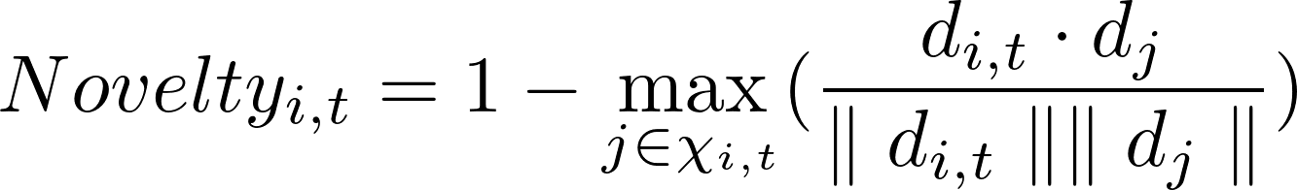

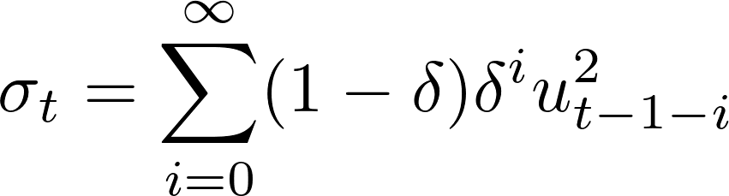


Empirical Analysis
Fresh News and Stale News
For each article for firm i on day t, we calculate its cosine similarity with all articles about firm i on the five trading days prior to t (denoted by the set )
Stock volatility
Calculate idiosyncratic volatility from residuals of a market model using the preceding 250 daily return observations.
Estimate the conditional idiosyncratic volatility via exponential smoothing according to the formula above.
where u is the market model residual and is chosen so that the exponentially_x0002_weighted moving average has a center of mass of 60 days.

Slide 16



Empirical Analysis
Comparison Versus Dictionary Methods and RavenPack
Dictionary-based sentiment scoring:
RavenPack News Analytics:
Portfolio spanning test: For each sentiment-based trading strategy, regress its returns on the returns of each of the competing strategies, while also controlling for daily returns to the five Fama-French factors plus the UMD momentum factor.
If a trading strategy has a significant α after controlling for an alternative, it indicates that the underlying sentiment measure isolates predictive information that is not fully subsumed by the alternative. Likewise, the measures the extent to which trading strategies duplicate each other.

Slide 17
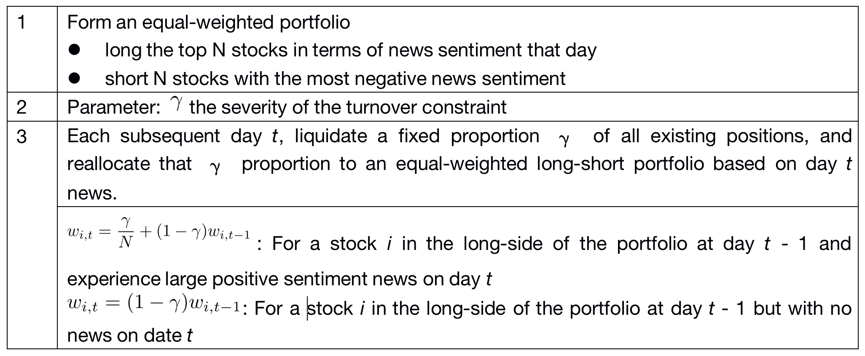
Empirical Analysis
Practical asset management experiment -- taking into account trading costs
Novel trading strategy: EWCT ( exponentially-weighted calendar time) portfolio
i) turns over (at most) a fixed proportion of the existing portfolio every period
ii) assigns weights to stocks that decay exponentially with the time since the stock was in the news.

Slide 18
Empirical Analysis
Practical asset management experiment -- taking into account trading costs
The turnover parameter simultaneously governs both the size of the weight spike at news arrival (the amount of portfolio reallocation) as well as the exponential decay rate for existing weights.
The EWCT strategy guarantees daily turnover is never larger than γ.

Slide 19
Some typo
1. P5: We occasionally work with a subset of rows from D, where the indices of columns included in the
subset are listed in the set S.
2. P17: count of words
3. P15 and P20: table 2, table 3, unit of return is confusing
4. P29: moving down

